Slide 1
Detection Of Fake Currency Using Image Processing
Team Members:
Shishir Mathur -15bce1105
Vibhu Sharma -15bce1116
Nikhil Yadav - 15bce1267

Slide 2
ABSTRACT
The main objective of this project is fake currency detection using the image processing. Fake currency detection is a process of finding the forgery currency. After choose the image apply pre- processing. In pre-processing the image to be crop, smooth and adjust. Convert the image into gray color. After conversion apply the image segmentation. The features are extracting and reduce. Finally compare the image into original or forger

Slide 3
Overall Algorithm:
A. Image of paper currency will be acquired by simple scanner or digital camera. B. The image acquired is RGB image and then it will be converted into gray scale.
C. Edge detection of the whole gray scale image will be performed. D. After detecting edges, the four characteristics of the paper currency will be cropped and segmented.
E. After segmentation, the characteristics of the paper currency will be extracted. F. The characteristics of test image are compared with the original pre-stored image in the system.
G. If it matches then the currency is genuine otherwise counterfeit.

Slide 4
Modules: Image Acquisition:
The first stage of any vision system is the image acquisition stage. After the image has been obtained, various methods of processing can be applied to the image to perform the many different vision tasks. Performing image acquisition in image processing is always the first step in the workflow sequence because, without an image, no processing is possible. There are various ways to acquire image such as with the help of camera or scanner. Acquired image should retain all the features.

Slide 5
Pre-processing:
The main goal of the pre-processing to enhance the visual appearance of images and improve the manipulation of datasets. Pre-processing of image are those operations that are normally required prior to the main data analysis and extraction of information. Image preprocessing, also called image restoration, involves the correction of distortion, degradation, and noise introduced during the imaging process.

Slide 6
Gray Scale Conversion:
The image acquired is in RGB color. It is converted into gray scale because it carries only the intensity information which is easy to process instead of processing three components R (Red), G(Green), B(Blue). to take the RGB values for each pixel and make as output a single value reflecting the brightness of that pixel. One such approach is to take the average of the contribution from each channel: (R+B+C)/3.

Slide 7
Edge Detection:
Edge detection is the name for a set of mathematical methods which aim at identifying points in a digital image at which the image brightness changes sharply. Edge detection is a fundamental tool in image processing, machine vision and computer vision, particularly in the areas of feature detection and feature extraction. Edge detection is an image processing technique for finding the boundaries of objects within images.

Slide 8
Feature Extraction:
Feature extraction is a special form of dimensional reduction. When the input data to analgorithmis too large to be processed and it is suspected to be very redundant then the input data will be transformed into a reduced representation set of features. Transforming the input data into the set of features is called feature extraction.

Slide 9
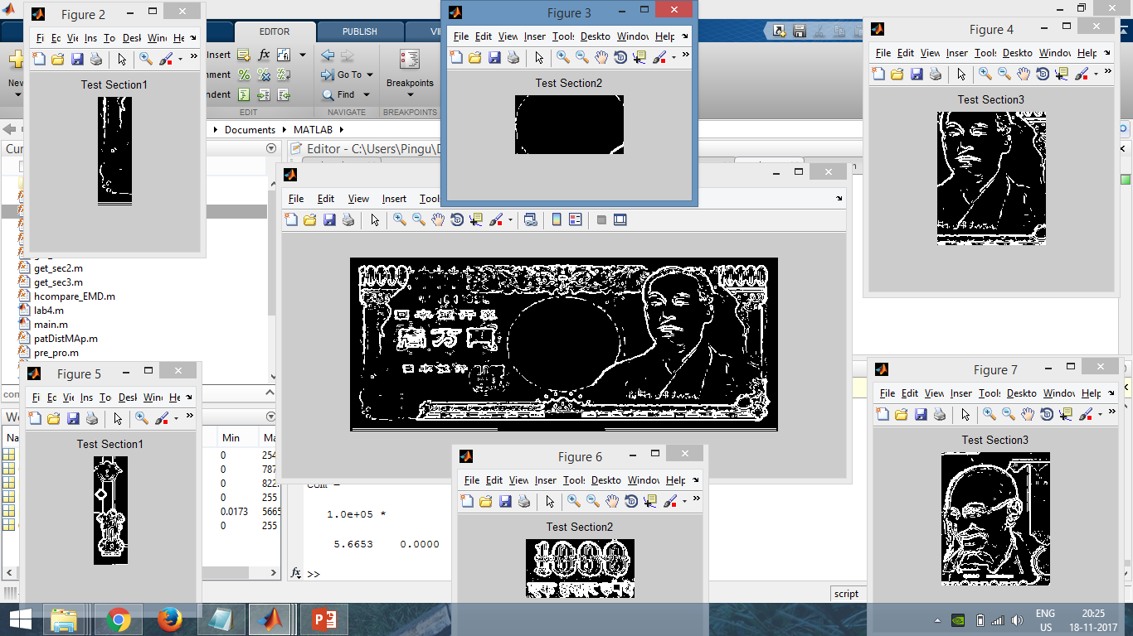
Results(Screenshots)

Slide 10
Conclusion:
This project proposed fake currency detection using image processing. In image pre-processing the image was cropped, adjusted and smoothed. Then the image converted into gray scale. After conversion the edges are detected. In edge detection used the sobel operator. Next the image segmentation is applied. After segmentation the features are extracted. Finally compared and find the currency original or fake.

Slide 11
REFERENCES
[1] Yufeng Kou, Chang-Tien Lu, Sirirat Sinvongwattana S. ans Yo-Ping Huang, Survey of Fraud Detection Techniques, IEEE International Conference on Networking, Sensing & Control, 0-78038193-9/04/$17.0020 2004 IEEE.
[2] D. Alekhya, G. DeviSuryaPrabha and G. Venkata Durga Rao, Fake Currency Detection Using Image Processing and Other Standard Methods, International Journal of Research in Computer and Communication Technology, Vol 3, Issue 1, January- 2014
[3] Indian Currency Identification Using Image Processing Shyju S1, Prof. Thamizharasi A2
[4] Currency Recognition System Using Image Processing S. M. Saifullah, AnikaRahmanAnanna, Md. Shakhawat Hossain, Md. Jaouad Hossain,Md. SaniatRahman Zishan
[5] Indian Currency Recognition and Verification Using Image Processing
Ingulkar Ashwini Suresh, Prof.P.P.Narwade
[6] Currency recognition system using image processing Yaojia Wang Siyuan Lin June 2010

